Slide 1
Systematic age, sex and temporal trends analysis of human exposure to multiple chemicals in Australia
Xingyue(Sherry) Zhang
4/20/22
Notes:
Database to characterize trends to human exposure to … in Australia

Slide 2
Outline
Introduction
Methods
Results and Discussion
Conclusions

Slide 3
Introduction

Slide 4


Introduction
Why do we need trend analysis?
To characterize an individual's exposures to chemicals over life, we need to understand how chemical biomarker concentrations change over time, by age, sex and other factors
To identify chemicals which vulnerable population are particularly exposed to, e.g. children
What have been done in previous studies? (Potential gap)
Substantial research has been done on age and temporal trends of human exposure to BFRs, DOX, OCPs, PCBs and PFASs
Most of those existing studies focus on individual class of compounds
Data coverage for children (< 5 y/o) is limited due to ethical considerations and the limited amount of blood that can be collected at a young age
Notes:
Rather than analyzing their trends together and contrasting their respective behavior

Slide 5
Objectives
Main objective:
Use pooled samples to provide a systematic analysis of age, sex, and time trends across multiple chemical classes (BFRs, DOX, OCPs, PCBs and PFASs)
More specifically, this study aims to
Set up a unified database of chemicals measured in pooled blood and serum samples from four labs in Australia
Examine the temporal and age trends of all chemicals, identify chemicals with high concentrations in children, particularly in children under 5
Detailed analysis of PFASs trends
Compare results with NHANES research (Nguyen et al., 2019)

Slide 6
Methods

Slide 7




Steps
330 pooled samples
Gathered from 2002-2017 in Australia by QAEHS;
Analyzed by 4 labs
Raw data
244 biomarkers
S W V PFOA
Cleaning
S: Serum
W: Wet weight adjustment
V: Value
PFOA: Chemical
Harmonize Codenames
Check outliers and null values
Detect low detection rate over time
Statistical Analysis
Multivariate Regression
Coefficient analysis
Comparison with NHANES
Distributions
Visualization
Notes:
QAEHS: Queensland Alliance for Environmental Health Sciences
Data analysis starts with data collection,
7

Slide 8
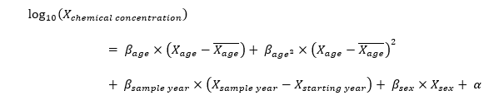
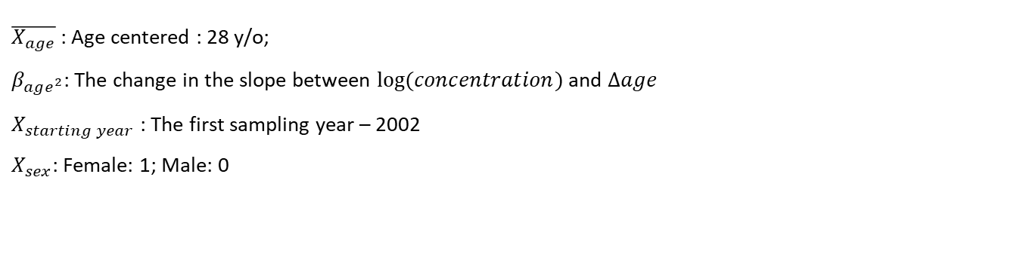
Regression
Only include chemicals with detection rate >= 50%
$\overline{X_{age}}$ : Age centered : 28 y/o;
$β_{age^{2}}$: The change in the slope between $log⁡(concentration)$ and $Δage$
$X_{starting year}$ : The first sampling year – 2002
$X_{sex}$: Female: 1; Male: 0
Notes:
we use centered age to reduce the collinearity between linear and quadratic age predictors
We use this model to evaluate the influence of age, sample year, and sex

Slide 9
Results

Slide 10
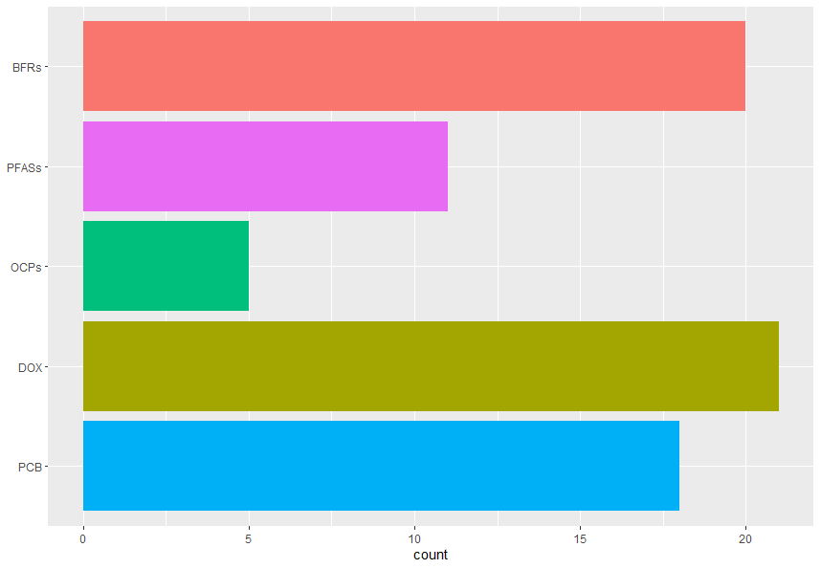
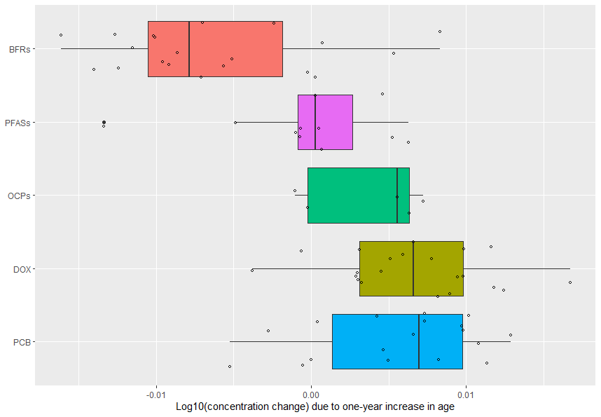
Database and data characterization
↓ Decreasing with age
↑ Increasing with age
75 chemicals in total
$$β_{age}$$
Notes:
BFRs show negative association with age;
PFASs show little to no variation with age;

Slide 11
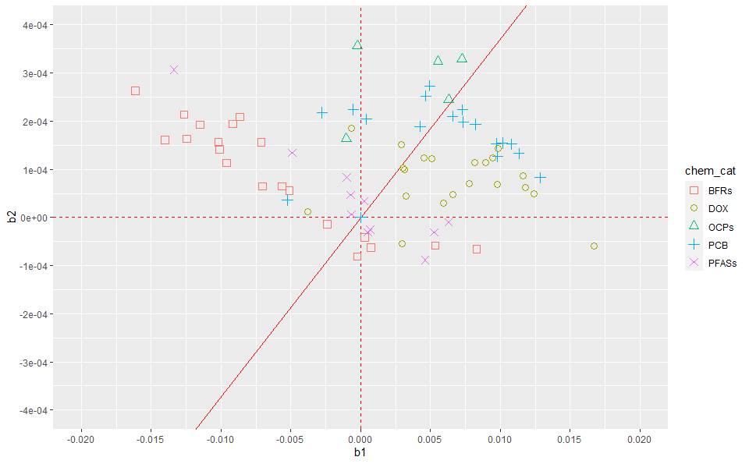
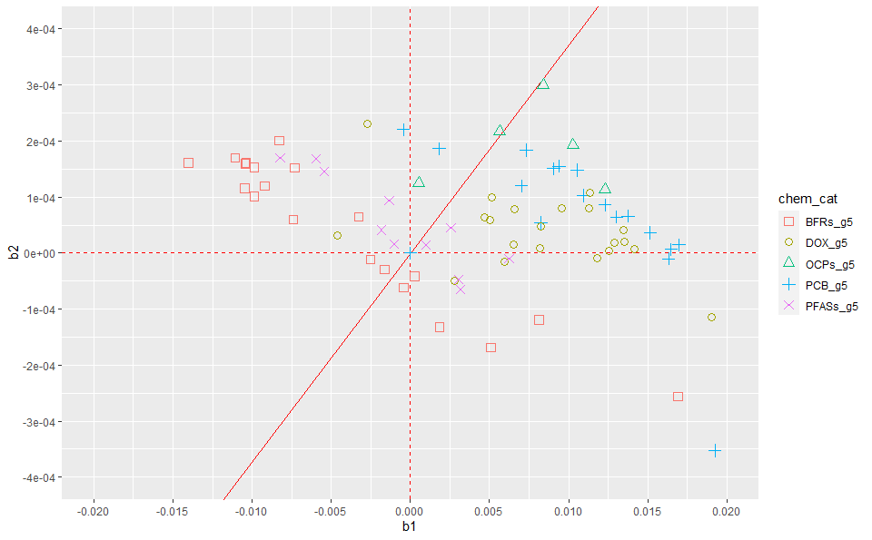



Age, time, and sex trends of BFRs, DOX, OCPs, PCBs, PFAS
$$Boundary line: \frac{β_{age^{2}}}{β_{age}}=\frac{1}{\overline{X_{age}}−X_{age}}=\frac{1}{28−5}=\frac{1}{23}$$
$$β_{age^{2}}$$
$$β_{age}$$
With children below 5 years old
Without children below 5 years old
Notes:
$$−\frac{b}{2a}≈30$$
summarize the results of age from the quadratic regression model by presenting the association between bage and bage2
Left, and upper region tend to have a downward and convex curve, implying the highest biomarker levels for the youngest participants.

Slide 12
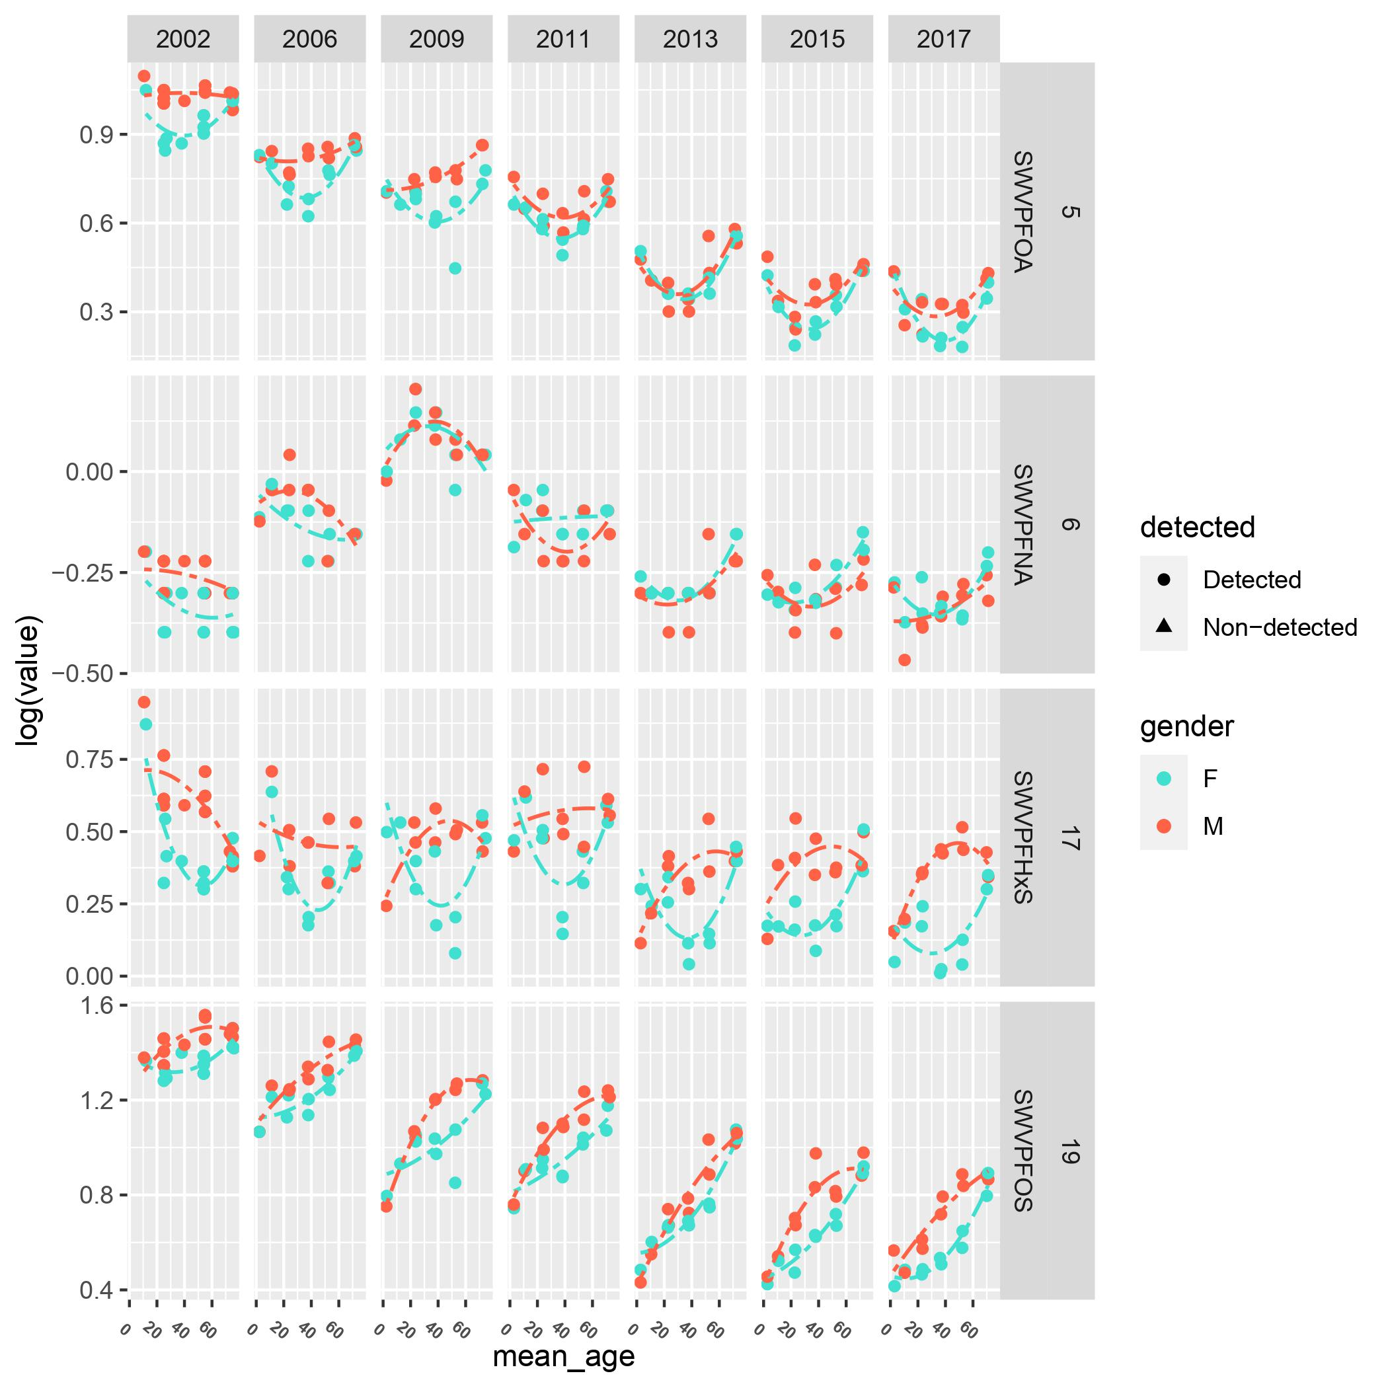
Age trend of PFAS
PFOA concentrations decrease before 30 y/o but then rise
The PFNA exhibits similar trends, except for 2006 and 2009 when the trends are reversed
Females and males exhibit distinct trends in PFHxS:
Males' concentrations peak around the age of 30
while females' concentrations are lowest for 30 -year-old (menstrual blood loss)
PFOS concentrations appear to increase from birth across all years
Notes:
Patterns of PFAS concentration by age vary in Australia.

Slide 13
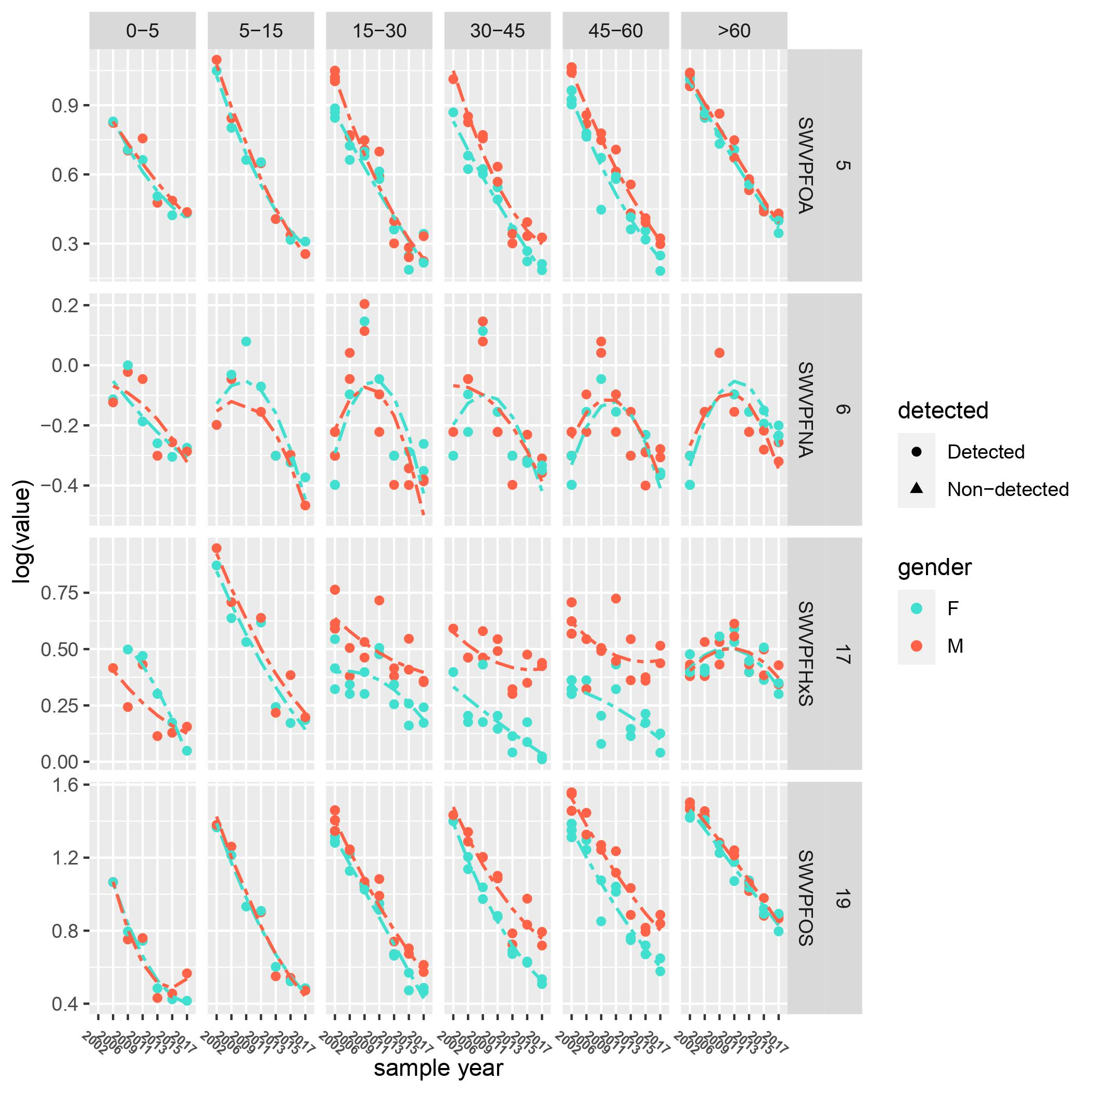
Time trend of PFAS
Over the last 15 years, PFOA and PFOS ↓ 5x, PFHxS ↓2x
PFNA concentrations peaked in 2009 before decreasing in the last decade
The decreasing trends are not consistent across all age groups: PFOA decreases more slowly in children, whereas PFHxS declines more slowly in the elderly
Notes:
Temporal trend of PFAS concentration across all age groups:
PFAS concentrations have been decreasing by a factor of 5 for PFOA

Slide 14
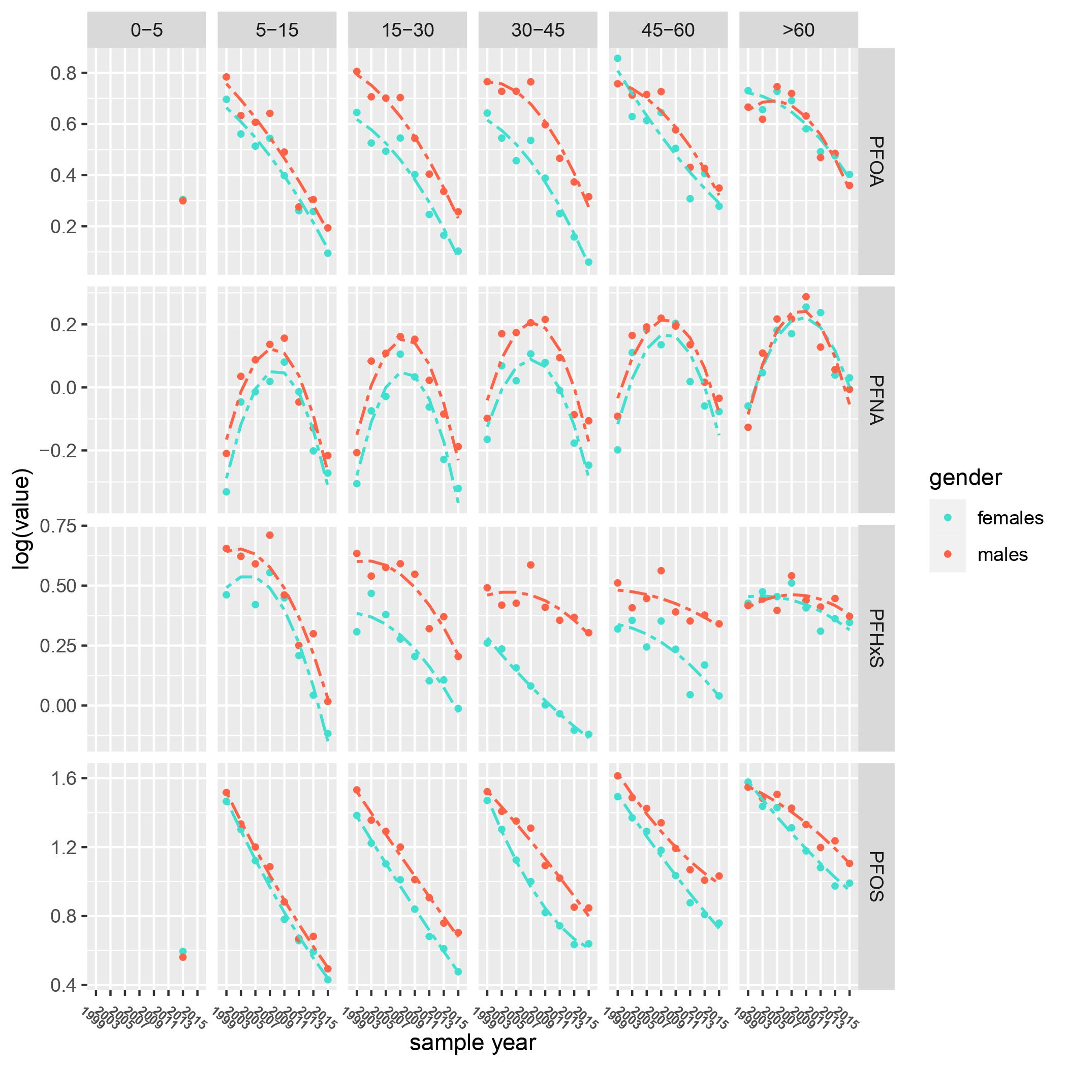
Comparison with NHANES
Time trends are very similar
NHANES
Australia
Notes:
Patterns of PFAS concentration by age vary in Australia.

Slide 15
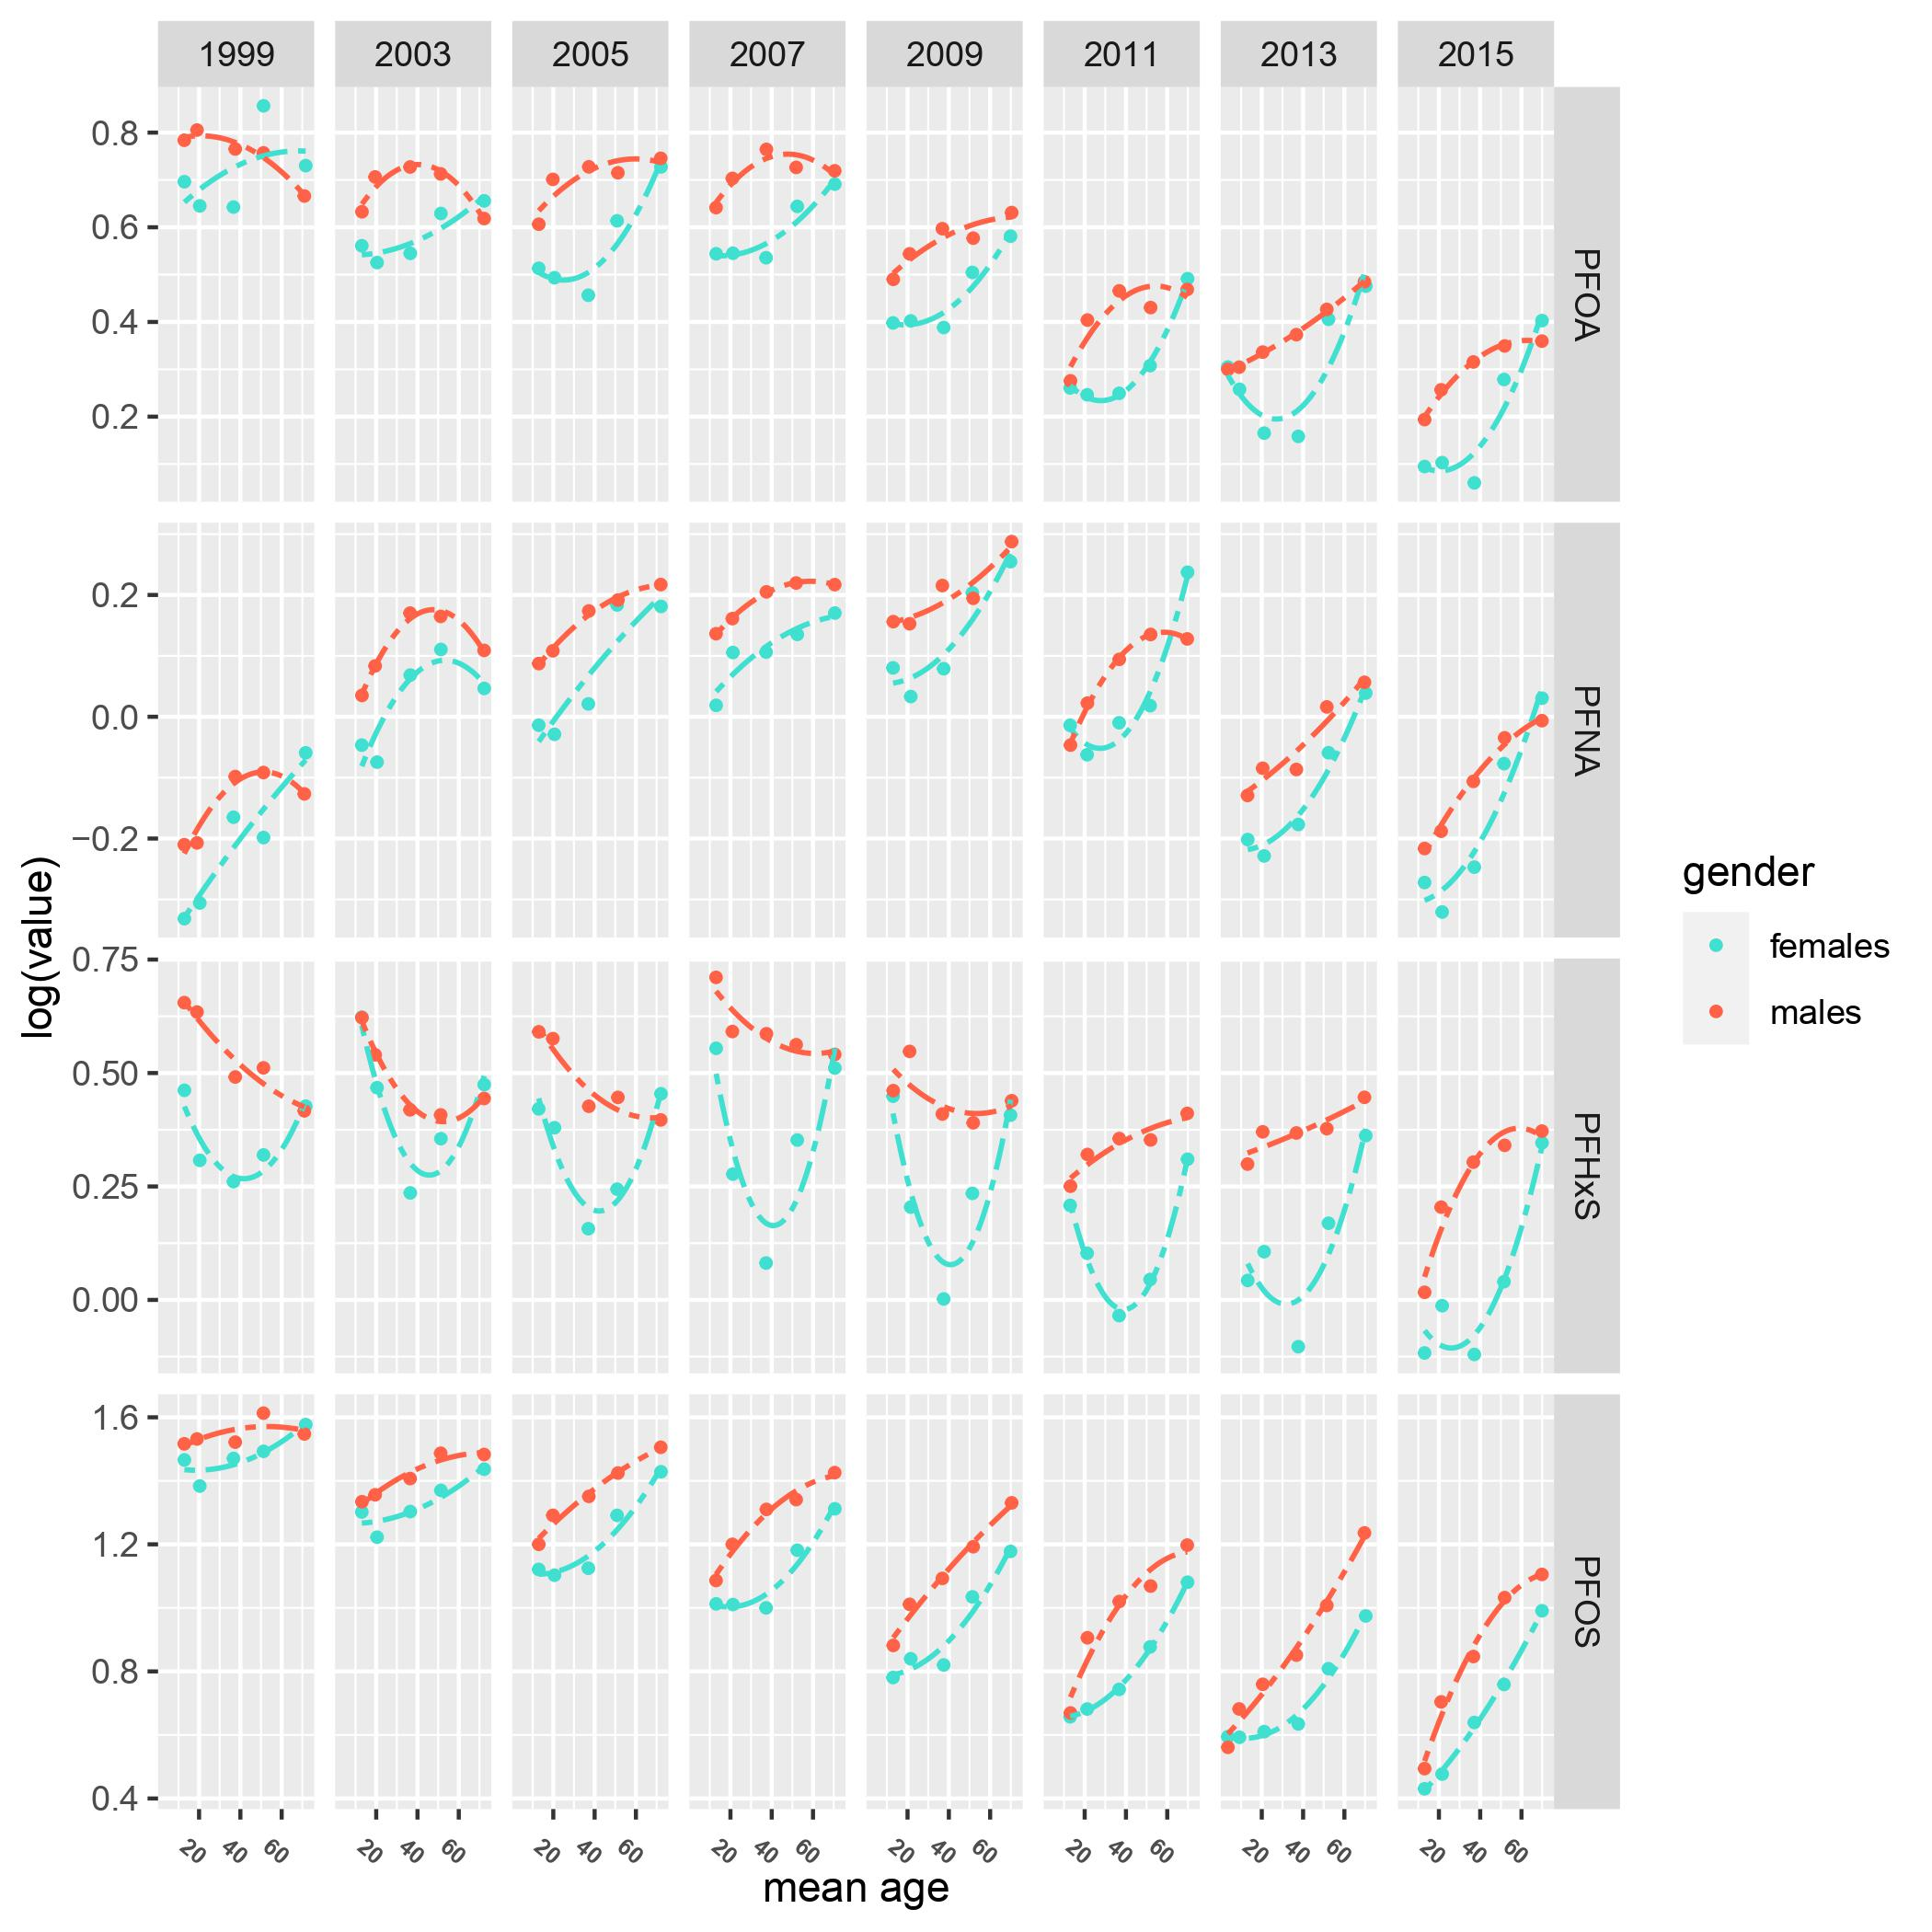
Comparison with NHANES
Age trends are a bit different
NHANES
Australia
Notes:
Patterns of PFAS concentration by age vary in Australia.

Slide 16
Conclusions

Slide 17
Conclusions
Generally, BFRs are negatively associated with age, indicating that children are more susceptible to BFRs exposures
In contrast, most DOX and PCBs increase with age, suggesting an accumulative effect in older adults
Age trends of PFAS vary a lot by sex, especially for PFHxS;
Age patterns are different from NHANES especially for men
Time trends of PFAS are relatively consistent across sex;
Time patterns show a certain similarity with results derived from the NHANES data
Notes:
PFHxS: Females and males exhibit more distinct trends in PFHxS. Males' concentrations peak around the age of 40, while concentrations are the lowest for women at the same age.

Slide 18
Thanks for your listening!

